Slide 1
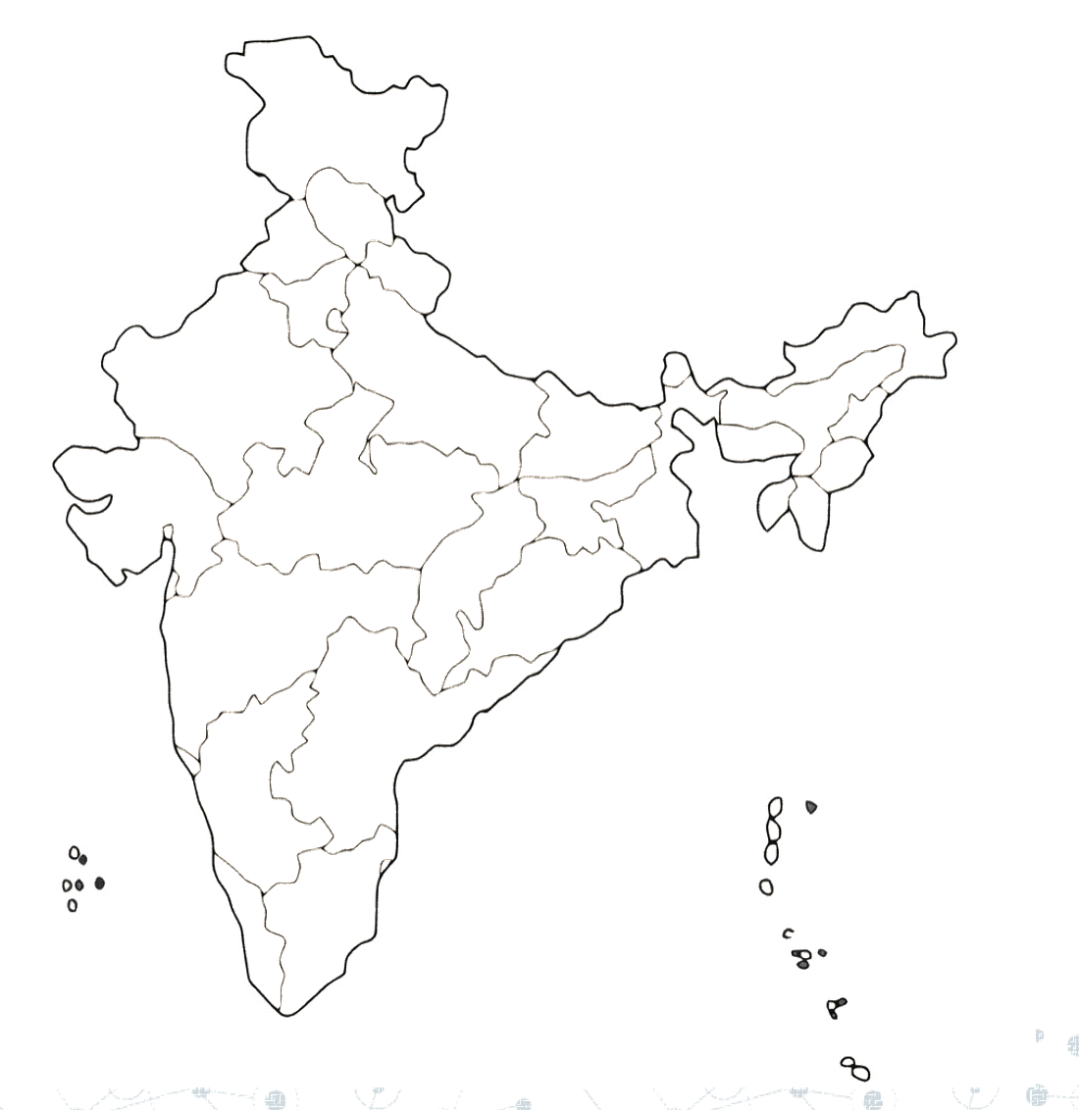
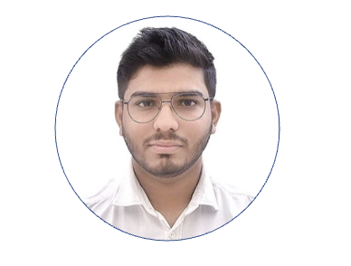
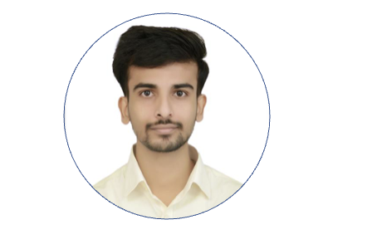
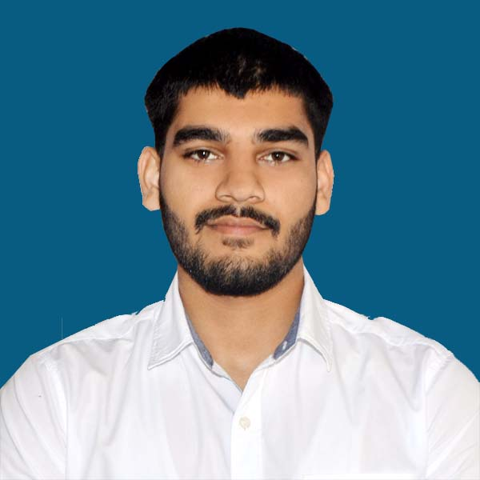

Team ASH
Harsh Soni
Shivansh Rastogi
Akhil

Slide 2
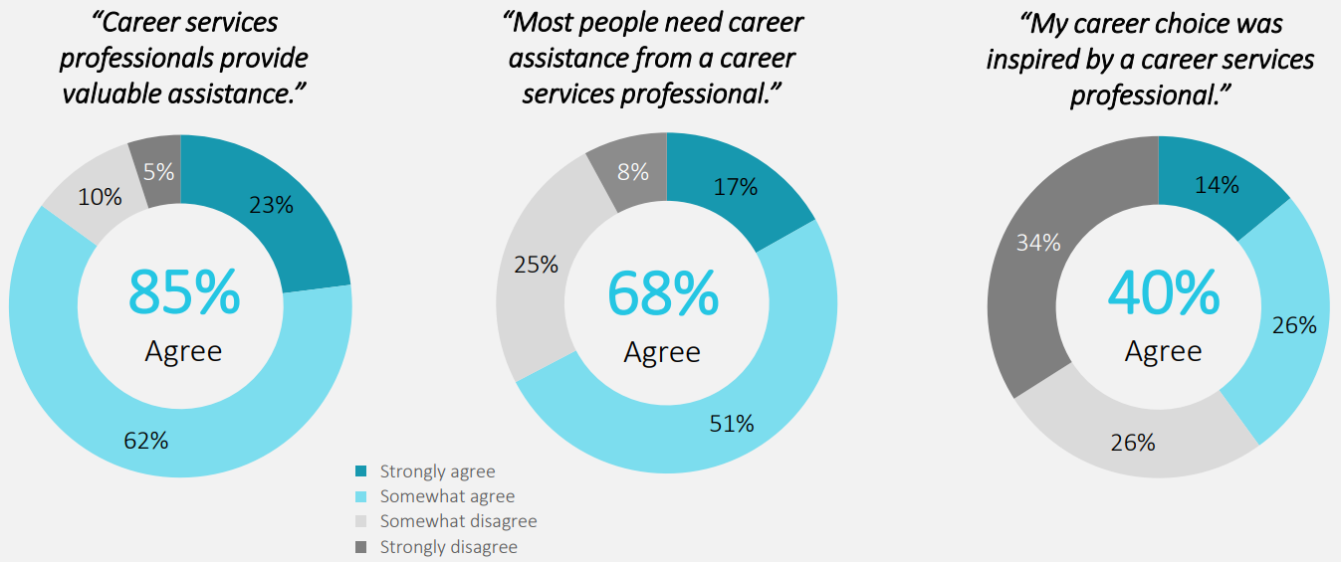
Mentorship Gap
According to a survey by the American Council on Education, 83% of college seniors reported that they wished they had received more mentorship and guidance during their academic journey. ASH can fill this mentorship gap by connecting juniors with seniors or providing mentorship through virtual channels.
Source - 2021 Harris Poll - Perceptions of Career Development from Working America commissioned by - The National Career Development Association (NCDA)

Slide 3
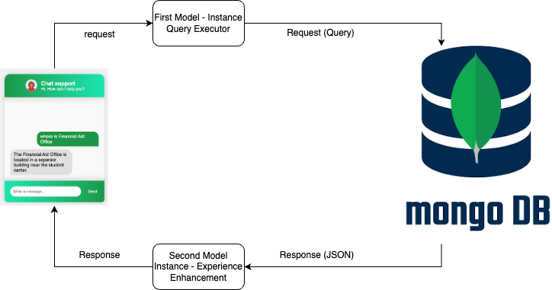
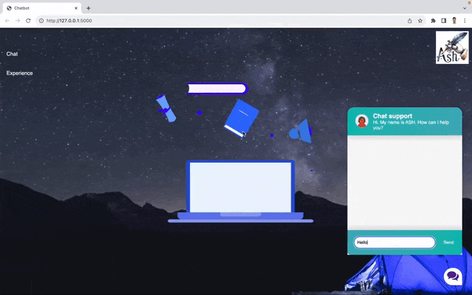
Our Solution

Slide 4








Why this Model?
Best Model
(175 Billion Parameters)
Wide Range of Scenarios
Meta data
Ease of Use and Simplicity
Pretrained
Flexibility
Maintenance and Security
Scalability

Slide 5

Support We Need
Let’s grow together with “Senior ASH”

